Slide 1

Modernization of the EU – Turkey Customs Union
Trade and Sustainable Development
Dilyana Slavova
REX Section President, EESC
Adana, February 2018

Slide 2

Background
The Customs Union entered into force on 31 December 1995. It covers all industrial goods but does not address agriculture (except processed agricultural products), services or public procurement. Bilateral trade concessions apply to agricultural as well as coal and steel products.
In addition to providing for a common external tariff for the products covered, the Customs Union foresees that Turkey is to align to the acquis communautaire in several essential internal market areas, notably with regard to industrial standards.
In December 2016, the Commission proposed to modernize the Customs Union and to further extend the bilateral trade relations to areas such as services, public procurement and sustainable development. The Commission proposal was based on comprehensive preparatory work throughout 2016 which included a public consultation with stakeholders, a detailed Impact Assessment and also a study by an external consultant. The Commission's proposal is currently being discussed in the Council.
Over the twenty years since the CU came into effect, the EU acquis has widened to include areas that were not regulated previously.

Slide 3
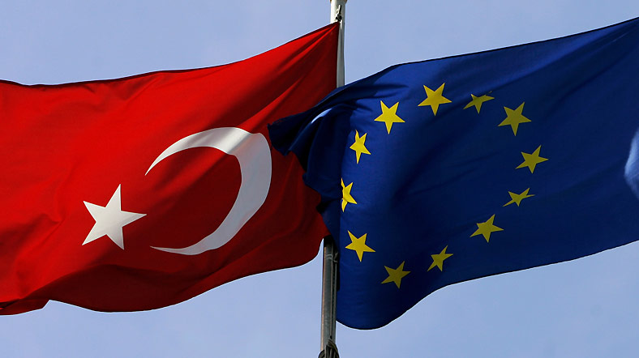
TSD Approach
The new conditions in world trade that have been developing over recent years have prompted the EU to launch a new round of global trade agreements focusing on improved provisions in a wide range of areas, with the aim of promoting modern forms of trade as well as applying EU principles and the EU acquis. The Trade for All Communication from the EC must constitute the basis for EU-Turkey negotiations.
EU citizens rightly expect that EU trade agreements with our international partners should support workers' rights, environmental and climate objectives and enhance global governance in these fields. The trade and sustainable development chapters include ambitious commitments on labour rights and environmental protection, as well as an active role of civil society.
The EU-Korea FTA was the first time a TSD chapter was included and this is now in its sixth year of implementation. The TSD chapters in the EU agreements with Central-America, Colombia and Peru have each had 3 years of implementation, those with Georgia and Moldova for over a year and the one with Ukraine for one year.
Over the last two years, interest in labour and environment provisions in trade agreements has intensified. Discussions are taking place within the European Parliament, Council, in Member States, third countries and among stakeholders including NGOs and civil society.

Slide 4

Scope
Existing TSD chapters in EU trade agreements contain a comprehensive set of binding provisions, which are anchored in multilateral standards, notably ILO conventions and Multilateral Environmental Agreements (MEAs). The EU approach treats labour and environment, including climate protection, on an equal footing in the same institutional framework.
In terms of scope, EU TSD provisions therefore seek to promote:
• The effective implementation of the fundamental international labour conventions and beyond as regards other ratified up-to-date international labour conventions and working conditions and MEAs.
• Sustainable management of natural resources in areas of low carbon development, forestry, fisheries, biodiversity, including fighting illegal harvesting practices and promoting corporate social responsibility and fair and ethical trade initiatives.
• A level playing field, by not lowering labour and environmental standards for the purpose of improving trade or attracting investment and ensuring effective implementation.

Slide 5
Civil society mechanism
The institutional structure of EU TSD chapters is designed to be inclusive, through platforms where civil society can play an advisory role.
These platforms include Domestic Advisory Groups (DAGs) on the side of each FTA partner, and a civil society forum which brings together civil society organisations from both FTA partners.
They participate in the monitoring of the FTA implementation through direct exchanges amongst civil society actors and with governments.
The DAG usually consists of 12 to 15 members, with a stable and balanced composition of business organisations, trade unions and diverse interest organisations, meeting regularly over the year. The role of the DAG is to assist the government level in identifying Trade and Sustainable Development related problems in the implementation of a trade agreement.
The Civil Society Forum brings together the DAG from each FTA partner and also enables a broader participation of civil society organisation, with organisations not included in the DAGs. The Civil Society Forum meets once per year. At these joint meetings joint recommendations to the FTA partners are elaborated.

Slide 6
Role of the DAGs
Identify priority areas within the trade and sustainable development chapter where concrete and urgent action needs to be taken.
Identify priority areas for cooperation activities.
Inform the government level of shortcomings in the legislation or its implementation, and signal the requested actions related to the implementation of the trade agreement.
Propose relevant projects or cooperation activities which can contribute to better implementation of multilateral labour or environmental instruments.

Slide 7

TSD in the Modernization of the EU – Turkey Customs Union
EESC Focus
The EESC believes that ongoing developments have rendered the current Customs Union (CU) agreement obsolete and that the parties to the agreement will have to start serious negotiations on strengthening their economic ties by establishing a new type of trade agreement that reflects current needs.
The EESC considers that Turkey remains a very important partner and that the political will exists to increase levels of cooperation, but only provided that compliance with the fundamental European values and the principles of democracy, the rule of law and human rights is ensured
The EESC believes that the new agreement should contain new chapters that reflect additions to EU law and practice, since these continue to expand and be revised, together with updated provisions addressing the areas that have proven to be problematic in the implementation of the CU with Turkey.
A new trade policy cannot be one-dimensional but must be multilevel and complex, embracing a multitude of areas of activity, if it is to be regarded as effective and beneficial to those affected, such as workers, consumers and SMEs.
Negotiations on trade and investment agreements are now manifestly not only economic in character but constitute a broader socio-economic project to introduce multidimensional and multilevel reforms.

Slide 8

EESC Focus
Sustainable development and protection of the environment are now of equal importance and integral to these values, particularly since the adoption of the Paris Agreement by the EU and the new SDGs by the UN Economic and Social Council.
The EU decided to proceed on the basis of three basic principles to achieve the above. Those principles are:
a) Effectiveness: so that both macroeconomic (e.g. the economic situation of EU countries in crisis) and microeconomic (e.g. SME) needs are taken into account, ensuring optimum adaptability to new trade projects;
b) Transparency: through greater visibility and participation of as many stakeholders as possible in negotiations;
c) European values and models: an evolving concept that has now been extended to include issues such as the protection of human rights and fundamental freedoms (including those of workers), sustainable development and combating corruption.

Slide 9
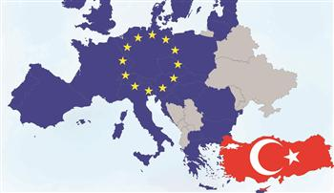


THANK YOU!

